Slide 1


Cyber law and Professional Ethics
Unit- 1
Overview of Ethics……
Compiled by:
Khagaraj Paneru

Slide 2
Overview of Ethics
Ethics is a set of beliefs about what is right and wrong behavior within a society.
Every society creates a set of rules that guide what is generally accepted behavior. These rules make up a moral code, helping people know what’s right or wrong. However, these rules can sometimes contradict each other, leading to confusion about which rule to follow in certain situations. For instance, if you see a friend cheating on a test, you might struggle between being loyal to your friend and valuing honesty. In new or complex situations, people may need to apply existing rules in different ways or even create new guidelines.
Ethics is a branch of philosophy that deals with the principles of conduct of an individual or group. It works as a guiding principle as to decide what is good or bad. They are the standards which govern the life of a person. Some ethical principle are-
Truthfulness
Honesty
Loyalty
Respect
Fairness

Slide 3
Overview of Ethics
At its simplest, ethics is a system of moral principles. They affect how people make decisions and lead their lives.
Ethics helps member of a group understand their roles and responsibilities so they can work together to achieve mutual benefits such as security, access to resources, and the pursuit of life goals.
Our concepts of ethics have been derived from religions, philosophies and cultures.
A virtue is a habit that leads people to do what is good and acceptable, while a vice is a habit of doing things that are wrong or harmful.
Examples of virtues include fairness, generosity, and loyalty. Examples of vices are vanity, greed, envy, and anger.

Slide 4
Why to follow code of Ethics
Acting according to a code of ethics is important because it builds trust, promotes fairness, and helps maintain a positive reputation.
A code of ethics provides clear guidelines, helping people make consistent, respectful decisions even in challenging situations. This not only supports personal integrity but also fosters a sense of reliability and respect within a community, organization, or society as a whole.

Slide 5
Morals
Morals are the social, cultural and religious belief or values of an individual or group which tells us what is right or wrong.
They are the rules and standards made by the society or culture which is to be followed by us while deciding what is right.
It forms a common understanding of acceptable behavior. However, individual perspectives on morality can differ due to factors like age, culture, background, religion, life experiences, education, and gender.
While there is general agreement that actions like murder, theft etc are immoral, other behaviors may be viewed differently across cultures or even within the same society. Moral debates, such as those over issues like abortion or gun control, show that people can have different beliefs about what is right, with each side feeling their stance is morally justified.

Slide 6
Relation bet^{n} Ethics and Moral
Ethics and morals are closely related concepts that guide people’s understanding of right and wrong behavior, but they have distinct meanings:
Morals are the personal or social beliefs about what is right and wrong. They are shaped by cultural norms, traditions, religion, and personal experiences and vary across individuals and groups. Morals are the "what" in terms of behavior—defining which actions are acceptable or unacceptable.
Ethics, on the other hand, is the system or framework of rules and principles that guide how to apply these beliefs in various situations. Ethics provides the "how" and "why" of acting on moral beliefs, giving people a structured way to make fair, responsible decisions based on a shared set of standards.
In summary, morals are the beliefs about right and wrong, while ethics is the practical application of these beliefs within society. Ethics often seeks to create a common ground for diverse moral perspectives, helping people make fair and consistent choices.

Slide 7
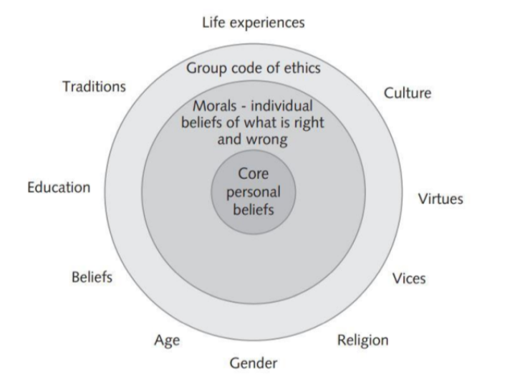
Relation bet^{n} Ethics and Moral

Slide 8
Law
Laws are formal rules established by governments or authorities that define what is legally allowed.
Laws are enforced by institutions such as police and courts, and they apply to everyone within a jurisdiction.
Unlike morals and ethics, laws are obligatory and carry penalties for violations.
Laws may not always align with personal morals; for example, while abortion may be legal in some places, individuals may still see it as immoral based on their beliefs.
Similarly it doesn’t provide complete guide to ethical behavior. It is because, an activity that is defined as legal doesn’t mean that it is ethical.

Slide 9
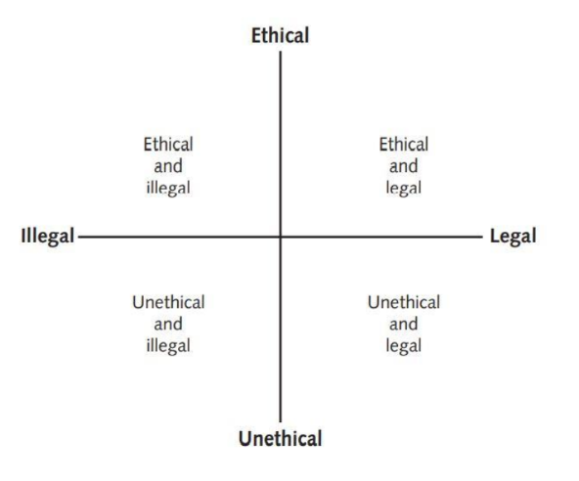
Law
Ethical but illegal: When a child is hungry and he stole a bread from a shop to feed.
Unethical but Legal: Keeping money that someone dropped is legal, but again many would find it unethical.

Slide 10
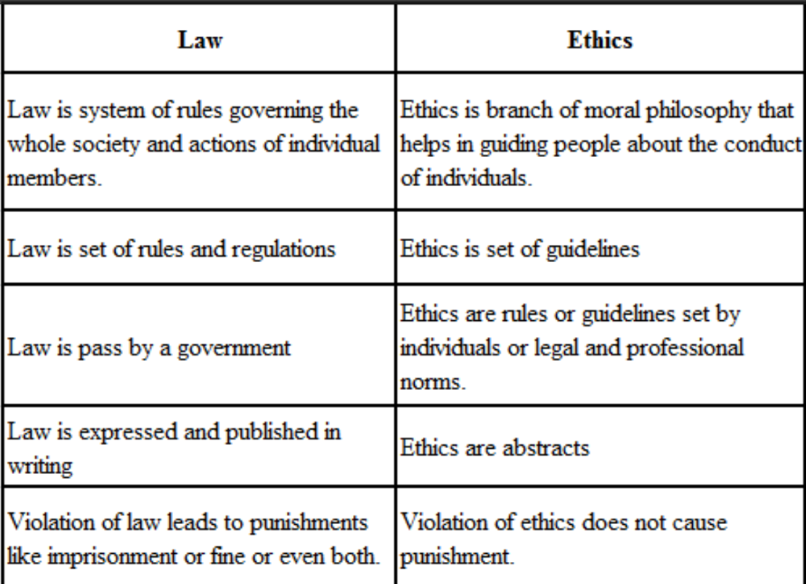
Law Vs Ethics

Slide 11
Ethics in Business
Ethics simply concerned with what is right and what is wrong in human behavior or it is a set of moral principles.
Business ethics refers to the socially determined moral principles which should govern business activities. For example;
Charging fair prices from customers,
Using fair weights for measurement of commodities,
Giving fair treatment to workers and
Earning reasonable profits etc.
Baumhart defines, “The ethics of business is the ethics of responsibility. The business man must promise that he will not harm knowingly.”
Business ethics refers to the standards for morally right and wrong conduct in business.
Ethical business behavior improves public image, earn people’s confidence and trust, and leads to greater success. Ethics and profits go together in the long run.
Unethical behavior can bring major reputational and financial risks.

Slide 12
Factors Effecting Unethical Practices in Business
1. Globalization: As business expand globally, they face challenges in maintaining ethical standards across different cultures.
2. Economic Pressure: Business may feel pressured to cut ethical corners to survive in a competitive and uncertain economic climate.
3. Ethical misconduct has occurred across many businesses, including in high-profile cases.
4. Unethical behavior is sometimes rooted in power and success, where influential individuals feel they can manipulate situations to their advantage.

Slide 13
Aspects of Business Ethics
1. Honesty and Transparency :
Businesses are expected to be honest in what they do. This means giving accurate information to customers about products or services and being open about any issues. For example, if a product has a defect, an ethical business will inform customers and make things right.
2. Fair Treatment of Employees :
Ethics in the workplace includes creating a safe, respectful environment for employees. This means fair pay, opportunities for growth, and no discrimination based on gender, race, or background. Ethical companies also protect employee rights and provide a safe work environment.
3. Responsibility to Customers :
Ethical businesses prioritize customers’ well-being. This includes creating quality products, being fair in pricing, and ensuring customers’ safety. For instance, if a company knows its product could harm users, they should address it or stop sales rather than putting profit over people’s safety.

Slide 14
Aspects of Business Ethics
4. Avoiding Corruption and Bribery :
In some businesses, bribes or gifts are given to gain favors, like faster approvals or contracts. Ethical businesses avoid this to keep processes fair. Bribery harms honest competition and can make it hard for trustworthy companies to succeed.
5. Environmental Responsibility :
Ethical businesses try to minimize their impact on the environment by reducing waste, conserving resources, and following sustainable practices. They avoid activities that could harm the environment or the health of nearby communities.
6. Compliance with Laws and Regulations:
Acting ethically means respecting the laws and rules set by the government.

Slide 15
Why ethics is important in business ?
Ethics is essential in business because it builds trust, enhances reputation, attracts customers, and promotes a positive work environment. Here’s why ethics plays such an important role:
1. Builds Customer Trust and Loyalty :
When businesses act ethically, they gain the trust of customers. Customers are more likely to support businesses that prioritize honesty, fairness, and quality.
2. Enhances Company Reputation :
A strong ethical foundation improves a company's reputation. Companies known for integrity and responsible practices are more attractive to customers, investors, and employees, and they are viewed positively in the community. This reputation becomes a valuable asset, helping the company stand out in competitive markets.
3. Encourages a positive Work Environment :
Ethical companies create environments where employees feel respected, valued, and fairly treated. This boosts morale and productivity, as employees are more likely to be engaged and motivated.

Slide 16
Why ethics is important in business ?
4. Attracts Investors and Partners :
Investors and business partners prefer to work with ethical companies, as they reduce the risk of fraud, lawsuits, and financial penalties. Companies with ethical practices are often seen as more stable and trustworthy, attracting long-term investment and partnership opportunities.
5. Reduces Legal Risks :
Acting ethically helps businesses comply with laws and avoid practices that could lead to legal trouble. Ethical companies are less likely to face fines, and other penalties, which can harm both finances and reputation.

Slide 17
Corporate Social Responsibility
Corporate Social Responsibility (CSR) is the idea that companies should act responsibly and ethically, not just for profit but also to positively impact the environment, communities, and their employees.
CSR means thinking beyond just financial success and considering how business activities affect people, society, and the planet.
CSR involves-
1. Environmental Responsibility :
CSR encourages companies to consider their environmental impact. This can include reducing pollution, conserving energy and water, and managing waste responsibly. For example, some companies reduce their energy use not only to help the environment but also to cut costs.

Slide 18
Corporate Social Responsibility
2. Community Responsibility :
CSR promotes giving back to local communities, often through charitable donations, volunteer programs, or supporting local events. By contributing to their communities, businesses build goodwill and create a positive image.
3. Employee Responsibility :
A responsible company considers the health, safety, and well-being of its employees. This might mean providing fair wages, safe working conditions, and opportunities for growth. When employees feel valued and supported, it leads to a more positive and productive workplace.
4. Supply Chain Sustainability :
Supply chain sustainability is about creating a supply chain that meets today’s needs without harming future generations. It focuses on fair labor, conserving resources, and respecting human rights to protect both people and the environment.

Slide 19
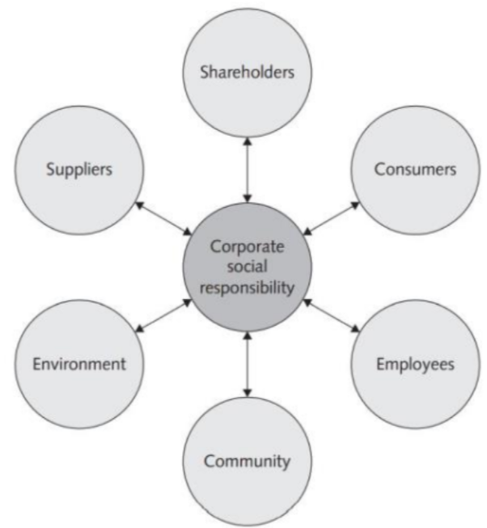
Corporate Social Responsibility

Slide 20
Why Fostering CSR and Good Business Ethics Is Important
Fostering Corporate Social Responsibility (CSR) and good business ethics is crucial for several reasons:
1. Gaining Community Support :
When a company acts responsibly and ethically, it earns the trust and respect of the community. This can helps to built better relationships with customers and local stakeholders that can lead to more support and better public image.
2. Consistency in Operations :
A commitment to ethical behavior helps ensure that the organization operates in a reliable and trustworthy manner, following clear and consistent standards.

Slide 21
Why Fostering CSR and Good Business Ethics Is Important
3. Fostering Good Business Practices :
Fostering Good Business Practices: Encouraging ethical behavior promotes fairness, honesty, and integrity. These qualities lead to a healthier and more productive workplace.
4. Legal Protection :
Ethical practices and CSR can help a company avoid laws and other legal problems. It is a way to stay on the right side of the law.
5. Avoiding Bad Publicity :
Acting responsibly can prevent scandals and negative news, which can damage a company’s reputation. Ethical companies are less likely to face damaging criticism.

Slide 22
Improving Business Ethics
Improving business ethics means making sure that a business follows fair, honest, and responsible practices in its operations, ensuring it treats people well, respects laws, and contributes positively to society.
1. Creating Code of Ethics :
A code of ethics is like a set of rules for how employees and management should behave in various situations. It outlines values like honesty, respect, and integrity. By clearly defining acceptable and unacceptable behavior, a business sets a standard everyone can follow.
Example: A retail company might include policies on fair pricing and responsible sourcing. This means the company should not inflate prices unnecessarily and should buy products from authorized suppliers.

Slide 23
2. Encouraging Open Communication :
Employees should feel comfortable discussing ethical concerns without fear of punishment. When people can openly speak about issues, businesses can address problems early and improve their ethical standards.
Example: A company could have an “open door” policy where employees can safely report instances of dishonest practices, like if someone is falsifying data in a report. This lets management address issues before they grow.
3. Providing Ethical Training :
Not everyone may fully understand the best ethical response in certain situations. Training helps employees recognize and handle ethical dilemmas effectively, preparing them for real-world situations.
Example: A bank might train employees on handling situations where they could be tempted to share customer information for personal gain. Training helps them understand the importance of protecting customers' private information and following legal requirements.

Slide 24
4. Promoting Fair Treatment and Diversity :
Treating everyone with respect and encouraging diversity creates a positive workplace and builds trust among employees and clients. Fair treatment also includes fair hiring practices, equal pay, and no tolerance for discrimination.
Example: A company could implement a policy ensuring that every employee, regardless of gender or background, has equal opportunities for promotions and salary increases.
5. Setting an Example from the Top :
Leaders who behave ethically set the tone for the entire organization. When executives and managers demonstrate high ethical standards, employees are more likely to follow it.

Slide 25
6. Appointing a Corporate Ethics Officer :
A Corporate Ethics Officer is responsible for making sure the company follows ethical standards. A business or company should hires someone to be the Ethics Officer, whose job is to review complaints, conduct investigations, and educate staff about ethics. They make sure the company follows its Code of Ethics and handle issues fairly.

Slide 26
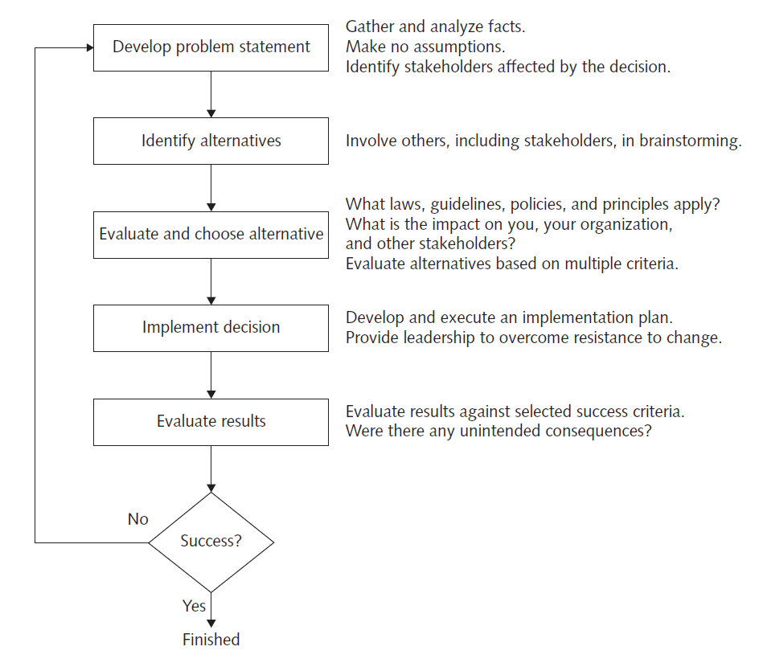
Ethical Considerations in Decision Making
We are all faced with difficult decisions in our work and in our personal life. Most of us have developed a decision-making process that we execute automatically, without thinking about the steps we go through. But the process generally follows the following 5 steps:

Slide 27
1. Develop Problem Statement :
A Problem statement is a clear, concise description of the issue that needs to be addressed. A good problem statement answers the following questions:
What do people observe that causes them to think there is a problem?
Who is directly affected by the problem?
Is anyone else effected ?
How often does the problem occur?
What is the impact of the problem ?
How serious is the problem ?
The development of a problem statement is the most critical step in decision-making process. Without a clear statement of the problem or the decision to be made, it is useless to proceed. If the problem is stated incorrectly, the chances of solving the real problem are diminished.

Slide 28
• Good problem statement: Our product supply organization is continually running out of stock of finished products, creating an out-of-stock situation on over 15 percent of our customer orders, resulting in over $300,000 in lost sales per month.
• Poor problem statement: We need to implement a new inventory control system. (This is a possible solution, not a problem statement.)
• Poor problem statement: We have a problem with finished product inventory. (This is not specific enough.)
We have to gather and analyze facts to develop a good problem statement. During this process, do not make any assumptions about the situation and carefully check key facts for validity.

Slide 29
2. Identify Alternatives :
Collect all relevant facts and information related to the situation. After gathering information brainstrom and analyze possible courses of action. Asses the potential consequences, both positive ad negative of each alternative.
3. Evaluate and Choose an Alternatives :
Once a set of alternatives has been identified, they must be evaluated based on numerous criteria, such as effectiveness at addressing the issue, the extent of risk associated with each alternative, cost, and time to implement. An alternative that sounds attractive but that is not feasible will not help solve the problem.
4. Implement the Decision :
Once an alternative is selected, it should be implemented in an efficient, effective, and timely manner. While implementing the decision consider the following questions:
• Why are we doing this?
• What is wrong with the current way we do things?
• What are the benefits of the new way for you?

Slide 30
5. Evaluate the Result :
After the solution to the problem has been implemented, monitor the results to see if the desired effect was achieved, and observe its impact on the organization and the various stakeholders. Were the success criteria fully met? Were there any unintended consequences? This evaluation may indicate that further refinements are needed. If so, return to the develop a problem statement step, refine the problem statement as necessary, and work through the process again.

Slide 31
Ethics in Information Technology
Information Technology refers to the hardware, software, networks, and other technology tools used to create, store, process, and exchange information.
Ethics in Information Technology (IT) involves understanding what is right and wrong when using computers, data, and other technology. It’s about making decisions that respect privacy, integrity, and the rights of others while using technology. As IT has become deeply integrated into everyday life, ethical concerns have become more significant.
The growth of the Internet, the ability to capture and store vast amounts of personal data, and greater reliance on information systems in all aspects of life have increased the risk that information technology will be used unethically.

Slide 32
Ethics in Information Technology
Example:
Many companies monitor employees’ emails and internet use to protect company assets, but this can conflict with workers’ privacy.
People often download music and movies without paying, and share it, which hurts
3. Companies send unwanted emails (spam) to millions as a cheap way to advertise.
Hackers steal personal data from company databases to commit fraud.
Students download online content for schoolwork without proper credit.
Websites use cookies or spyware to monitor user activities without their knowledge.

Slide 33
Major Ethical Area in IT
1. Privacy:
Respecting and protecting the personal information of individuals.
2. Intellectual Property :
Respecting ownership rights over digital content like music, software, and books.
3. Accuracy and Integrity :
Ensuring the correctness and reliability of information shared online or through digital systems.
4. Access :
Providing fair and equal access to technology and information for everyone.
5. Security :
Protecting systems and data from unauthorized access, attacks, or theft.

Slide 34
Goal of Ethics in IT
To promote responsible use of technology
To protect privacy and data security
To prevent abuse and misuse
To support fairness and transparency
To educate and raise awareness
To encourage open discussion
To balance technology and human values

Slide 35
Job, Work, and Profession
A job is a specific position or task that you do to earn money. It is often associated with employment, where you are hired to perform certain duties. A job can be temporary or permanent, full-time or part-time.
Work is a general term for any activity or task that you perform to achieve a goal. It can be paid or unpaid, formal or informal.
A profession is a career path that requires specialized knowledge, skills, and education. Professions are generally long-term commitments and involve a high degree of responsibility and follow ethical standards.
A job can be part of profession, but not all jobs are professional roles. For example, apart-time retail job is a job, but it’s not considered a profession.

Slide 36
IT Professionals
A profession is a type of career or occupation that requires specialized knowledge, education, and training.
IT Professionals are individuals who work in the field of Information Technology, applying specialized knowledge and skills to develop, manage, and maintain technology systems.
Are IT Workers Professionals ?
Many IT workers, such as software engineers, network administrators, security experts, data scientists, and database administrators, have specialized training, advanced knowledge and skills in their fields. These workers often undergo formal education, certifications, and extensive training, making them professionals in a general sense.
While many IT workers perform complex and specialized tasks that require significant expertise, they do not meet the legal requirements of a "professional" that require formal licensure issued by government or advanced academic study.

Slide 37
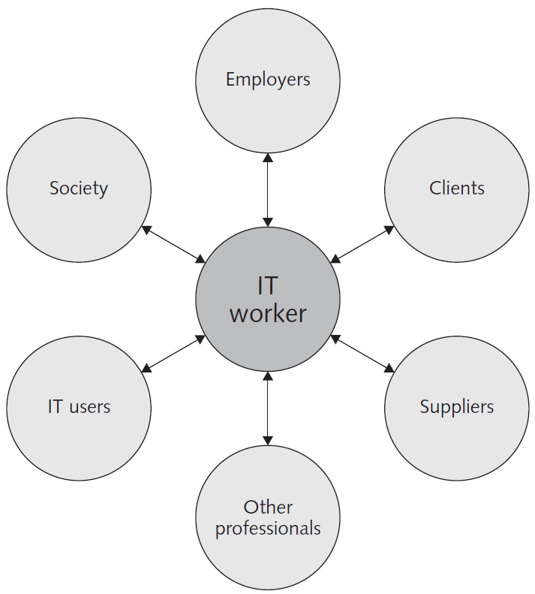
Managing IT Worker relationship
IT workers typically become involved in many different work relationships, including those with employers, clients, suppliers, other professionals, IT users, and society at large. In each relationship, an ethical IT worker acts honestly and appropriately.
These various relationships are as follows:

Slide 38
1. Relationships between It Workers & Employers
The relationship between IT workers and employers is based on agreements and clear expectations about the job. This includes the worker’s job title, responsibilities, salary, work hours, and benefits.
IT workers are expected to follow the company’s rules, like keeping company secrets, using resources properly, and respecting time-off policies. Flexibility might be allowed, like adjusting work hours when needed.
Ethical and legal responsibilities are crucial—IT workers must avoid illegal activities, such as software piracy or falsifying data. They must also protect trade secrets, like software designs and business plans.
Sometimes, IT workers might face ethical challenges, such as when they need to report harmful or illegal activities within the company to protect the public, , a situation known as whistle-blowing. So this relationship requires a balance of technical skills and ethical behavior to maintain trust and professionalism.

Slide 39
2. Relationships between It Workers & Clients
The relationship between IT workers and clients is about providing value to each other. IT workers offer services, hardware, or software that meet the client's needs within a set budget and timeline. In return, the client provides payment, information, and support for the project. This relationship is usually outlined in a contract that specifies who does what, when work starts, and how much it costs.
Both IT workers and clients need to trust each other. The IT worker relies on the client to give clear information and make informed decisions, while the client trusts the IT worker to use their expertise and act in their best interests. Problems can arise if IT workers recommend their own products or fail to report project issues honestly, which can lead to conflicts of interest or trust issues.
Issues like fraud, misrepresentation, or breach of contract can occur if one side does not meet their promises. Common causes of problems include unexpected project changes (scope creep), poor communication, delivery of outdated solutions, or complications with old systems that weren't disclosed at the start. Disputes often end in settlements outside of court to avoid long and costly legal battles.

Slide 40
3. Relationships between It Workers & Suppliers
The relationship between IT workers and suppliers involves collaboration and communication to ensure that the products and services provided meet the company's needs.
A positive working relationship is built by treating suppliers fairly, respecting industry timelines, and avoiding unreasonable demands. Good relationships with suppliers can lead to innovative solutions and cost savings. However, ethical concerns can arise, especially with gifts that might be seen as bribes.
IT workers must be cautious about what constitutes a gift versus a bribe, as accepting certain favors can create conflicts of interest. Transparency is key—gifts should be declared, and anything beyond a token gift is often declined to maintain integrity. Companies sometimes pool received gifts for charity to avoid ethical dilemmas.

Slide 41
Bribes Vs Gifts:
S.N | Bribes | Gifts
1 | Given to influence decisions or actions unfairly. | Given as a gesture of goodwill or appreciation without expecting specific favors.
2 | Expectation of specific favor or advantage in return. | No expectation of a return favor or specific action.
3 | Often secretive or hidden. | Usually given openly and can be disclosed.
4 | Typically illegal or unethical. | Generally legal and ethical if appropriate.
5 | Seen as an attempt to manipulate. | Seen as a sign of goodwill or generosity.

Slide 42
4. Relationships between It Workers & Other Professionals
The relationship between IT workers and other professionals is shaped by a sense of loyalty and the importance of maintaining trust within the field. Professionals often help each other by recommending colleagues for job positions and serving as mentors to guide less experienced members. However, ethical issues can arise in these relationships. One common problem is résumé inflation, where IT professionals exaggerate skills or qualifications. Although it might provide short-term benefits, it risks long-term harm to both the individual and the profession's reputation, potentially leading to job loss if discovered. Another ethical issue is the improper sharing of confidential information. IT workers often have access to sensitive corporate data, which, if mishandled, could result in serious consequences such as job termination or legal action. Trust and professionalism are essential to maintaining the integrity of relationships between IT workers and other professionals.

Slide 43
5. Relationships between It Workers & IT Users
The relationship between IT workers and IT users centers around understanding and meeting user needs while ensuring ethical use of technology. IT users are the individuals who utilize the hardware or software products created and maintained by IT workers to enhance organizational benefits or increase productivity. IT workers are responsible for identifying the users' needs, delivering solutions that fit those needs within budget and time constraints, and supporting the product. Additionally, IT workers play a crucial role in fostering an ethical environment, helping to prevent software piracy, discouraging the misuse of company computing resources, and safeguarding sensitive information. This collaborative relationship relies on effective communication, trust, and a commitment to ethical standards

Slide 44
6. Relationships between It Workers & Society
The relationship between IT workers and society involves a responsibility to ensure that their work does not cause harm and provides positive benefits.
Regulatory laws set safety standards, but they cannot cover all potential risks associated with IT products and services.
Society relies on IT professionals to anticipate the consequences of their actions and to address any risks that could negatively impact the public.
For instance, an error in a computer-based control system for a chemical plant designed by an IT worker could pose dangers to workers and nearby residents. Therefore, IT workers are expected to uphold ethical standards and professional conduct to safeguard society.
However, there is no single formal organization that governs the professional standards of IT workers to protect the public.

Slide 45
Encouraging Professionalism of IT Workers:
A professional is one who possesses the skill, good judgment, and work habits expected from a person who has the training and experience to do a job well.
Organizations—including many IT organizations—are desperately seeking workers who have the following characteristics of a professional:
They are an expert in the tools and skills needed to do their job.
They follow to high ethical and moral standards.
They produce high quality results.
They meet their commitments.
They communicate effectively.
They train and develop others who are less skilled or experienced.
IT workers of all types can improve their profession’s reputation for professionalism by:
Subscribing to a professional code of ethics
Joining and participating in professional organizations,
Obtaining appropriate certifications, and
Supporting government licensing where available.

Slide 46
Professional Code of Ethics
A professional code of ethics is a set of principles and core values that guide how people in a specific job or profession should act. It serves as a guidelines for ethical and responsible behavior in the workplace.
Most codes of ethics created by professional organizations have two main parts:
The first outlines what the organization hopes to become and
The second typically lists rules and principles by which members of the organization are expected to follow.
Many codes also include a commitment to continuing education for those who practice the profession.
Laws do not provide a complete guide to ethical behavior. Nor can a professional code of ethics be expected to provide an answer to every ethical dilemma—no code can be a definitive collection of behavioral standards.
However, following a professional code of ethics can produce many benefits for the individual, the profession, and society as a whole.

Slide 47
Benefits of Using Code of Ethics
Guides Ethical Decision-Making: Provides clear guidelines for making the right choices in difficult situations.
Maintains High Standards: Encourages professionals to uphold responsibilities and follow proper practices, avoiding shortcuts.
Builds Public Trust: Increases confidence from the public by ensuring professionals act with integrity and honesty.
Defines Acceptable Behavior: Clarifies what is considered right and wrong, making it easier to handle ethical issues.
Encourages Continuous Learning: Promotes ongoing education and improvement to stay updated in the profession.
Serves as a Self-Assessment Tool: Allows professionals to evaluate their behavior and make improvements if needed.

Slide 48
Professional Organization
A professional organization is a group that brings together individuals within the same field or profession to foster networking, knowledge-sharing, and skill development.
These organizations help members stay updated on industry trends, innovations, and best practices through resources like publications, conferences, and online platforms.
They often establish standards for professional behavior and competence by creating codes of ethics, promoting a sense of community, and enhancing the credibility of the profession.
In the IT field, professional organizations play a crucial role in connecting professionals, sharing new ideas, and supporting ongoing education in a rapidly evolving industry.
Here are few most prominent IT-related professional organizations in Nepal:

Slide 49

1. Computer Association of Nepal (CAN)
The Computer Association of Nepal (CAN) is a leading professional organization in Nepal that represents IT professionals and organizations. It aims to promote the development and growth of the IT industry in Nepal through advocacy, training, and networking. CAN plays a significant role in organizing events like the CAN InfoTech exhibition, where IT-related products and services are showcased. It also works on policy advocacy and creating awareness about the importance of IT in Nepal’s development.

Slide 50

2. Internet Society Nepal Chapter (ISOC Nepal)
ISOC Nepal is the local chapter of the global Internet Society, which is dedicated to promoting and ensuring the open development, evolution, and use of the internet for the benefit of people worldwide. ISOC Nepal focuses on internet governance, policy-making, and capacity-building in Nepal. It provides a platform for professionals to discuss issues related to internet security, accessibility, and sustainability in the region.

Slide 51
3. Internet Society Nepal Chapter (ISOC Nepal)
The Nepal Association for Software and IT Services Companies (NAS-IT) is a nonprofit organization representing the Nepalese software and IT services industry. Its primary mission is to promote the growth and development of the Nepalese software and IT services industry and to create an environment that encourages innovation and entrepreneurship in the industry.
NAS-IT aims to achieve this by advocating for policies and regulations that are favorable to the industry, promoting the use of technology in different sectors of the economy, fostering collaboration and knowledge-sharing among industry players, and providing training and capacity building programs to enhance the skills of professionals in the industry.
Overall, NAS-IT is committed to positioning Nepal as a hub for software and IT services in the region and contributing to the country's economic growth and development through the promotion of the software and IT services industry.

Slide 52
Certification
Certification is a process where a professional or product is officially recognized for meeting certain standards or having specific skills.
It is usually provided by a trusted organization to show that someone has learned or mastered certain knowledge.
For IT workers, certifications can help prove their expertise in a particular area, like a software or technology, and are often seen as valuable for job opportunities or career growth.
Many IT vendors—such as Cisco, IBM, Microsoft, SAP, and Oracle—offer certification programs for those who use their products. Workers who successfully complete a program can represent themselves as certified users of a manufacturer’s product. Depending on the job market and the demand for skilled workers, some certifications might substantially improve an IT worker’s salary and career prospects.
However, while certification shows that someone has the required knowledge, it doesn't always guarantee success or skill in real-world work, and experience is still important.

Slide 53
Licensing of IT Professionals
Licensing of IT Professionals refers to the process by which a government grants permission for an individual to practice in a specific profession after confirming that they have met the required qualifications and standards.
This typically involves passing an examination to prove their competence in that field.
Unlike certification, which is voluntary, licensing is mandatory for certain professions that could potentially harm public health, safety, or welfare if practiced by unqualified individuals.
In IT, while licensing is not as common as in fields like law or medicine, some regions or roles may require licenses, especially in areas like cybersecurity, network administration, or software engineering, where public safety could be impacted.

Slide 54
Licensing of IT Professionals
Licensing of IT Professionals refers to the process by which a government grants permission for an individual to practice in a specific profession after confirming that they have met the required qualifications and standards.
This typically involves passing an examination to prove their competence in that field.
Unlike certification, which is voluntary, licensing is mandatory for certain professions that could potentially harm public health, safety, or welfare if practiced by unqualified individuals.
In IT, while licensing is not as common as in fields like law or medicine, some regions or roles may require licenses, especially in areas like cybersecurity, network administration, or software engineering, where public safety could be impacted.

Slide 55
Encouraging ethical use of IT resources among users
The ethical use of IT resources is becoming a growing concern as companies provide employees with more devices like smartphones, tablets, and laptops to access corporate systems.
Key ethical issues in IT use include software piracy, inappropriate use of computing resources, and improper sharing of information.
1. Software Piracy :
Software piracy is the illegal copying, distribution, or use of software without proper authorization, similar to stealing because it denies developers the payment they deserve. Common forms include copying software from work to home computers without buying additional licenses, or downloading paid apps for free from platforms like Google Play Store and sharing them with others. This leads to financial losses for developers, discouraging them from future software development and innovation due to reduced revenue. Companies can combat this by enforcing clear IT policies, educating employees about the importance of licenses, and encouraging them to report instances of piracy to protect intellectual property and avoid legal consequences.

Slide 56
2. Inappropriate use of Computing Resources :
Employees sometimes misuse company computers to browse unrelated websites, chat, view inappropriate content, or play games. This wastes time and can lead to harassment lawsuits if offensive content is involved.
3. Inappropriate Sharing of Information :
Organizations handle private (employee or customer data) and confidential (company secrets) information. Sharing this without authorization violates privacy and can be harmful.
A famous example is the 2010 WikiLeaks incident, where a low-level IT user leaked confidential U.S. State Department documents, causing international tension.

Slide 57
Supporting the Ethical Practices of IT Users
The growing use of IT has increased the potential for new ethical issues and problems; thus, many organizations have recognized the need to develop policies that protect against abuses. Although no policy can stop wrongdoers, it can set forth the general rights and responsibilities of all IT users, establish boundaries of acceptable and unacceptable behavior, and enable management to punish violators.
Loyalty to a policy can improve services to users, increase productivity, and reduce costs. Companies can take several actions when creating an IT usage policy, as discussed below:
1. Guidelines for Hardware and Software :
Companies should provide clear rules on using work-related computers and software, ensuring employees have legal copies, whether working in the office or remotely.

Slide 58
2. Acceptable Use Policy (AUP) :
An AUP is a crucial document that outlines what is and isn't allowed with company IT resources. It includes the purpose, scope, acceptable and unacceptable uses, compliance, and consequences for violations. Information security teams monitor compliance.
3. Data Protection :
Organizations should structure their systems to limit data access only to employees who need it for their jobs, preventing unauthorized access to sensitive information.
4. Corporate Firewalls :
Firewalls are essential defenses that limit network access based on company policies. They block harmful websites and emails, reducing risks like viruses.
5. Compliance :
Compliance means following company policies, software licensing agreements, and relevant laws. Non-compliance can result in legal consequences, fines, or lawsuits.

